Slide 1
MODULE 3 :
Standard I/O, Redirection Pipes and Filters

Slide 2
Standard I/O in Unix
standard input (0: stdin)
The default place where a process reads its input
(usually the terminal keyboard)
standard output (1: stdout)
The default place where a process writes its output
(typically the terminal display)
standard error (2: stderr)
The default place where a process can send its error messages (typically the terminal display)

Slide 3
Stream Redirection
Unix includes redirection commands for each stream. These commands write standard output to a file.
Commands with a single bracket overwrite the destination’s existing contents.
Overwrite
> - standard output
< - standard input
2> - standard error

Slide 4
Stream Redirection(contd.)
Commands with a double bracket do not overwrite the destination’s existing contents.
Append
>> - standard output
<< - standard input
2>> - standard error
If a non-existent file is targeted (either by a single-bracket or double-bracket command), a new file with that name will be created prior to writing.

Slide 5
Redirecting Standard I/O
Standard input and output can be redirected
Lets you combine programs and Unix tools
Standard input is redirected from a file using <
wc < standard_input.txt
Any use of stdin will instead use standard_input.txt in this example

Slide 6
Redirecting Standard I/O (contd.)
$ wc < standard_input.txt
3 10 54
Output : Lines Words Characters
standard_input.txt
f af asfsdf afdsf
sdf gvddfg ssdffg
sdgf asff assdf

Slide 7
Redirecting stdout
Standard output is redirected to a file using >
cal 2007 > calendar.2007
wc -l < standard_input.txt > Lines.out
- the stdout of wc -l is directed to file Lines.out
$ wc -l < standard_input.txt > Lines.out
$ cat Lines.out
3

Slide 8
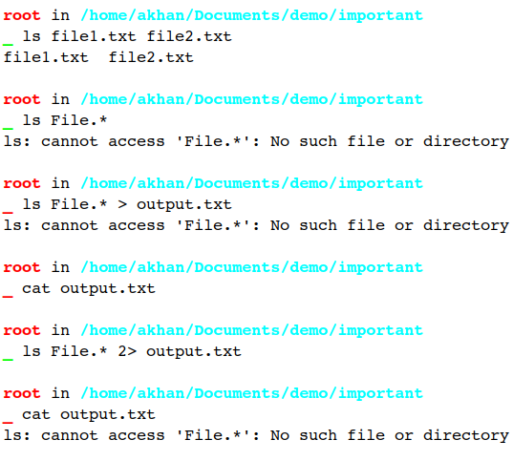
Redirecting stderr
Standard error can be redirected with 2>

Slide 9
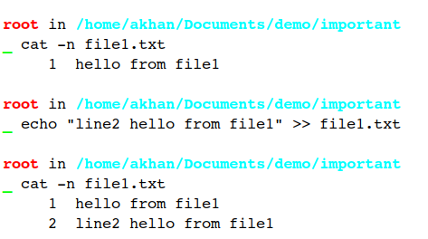
Appending to a File
The >> operator appends to a file rather than redirecting the output to a file

Slide 10
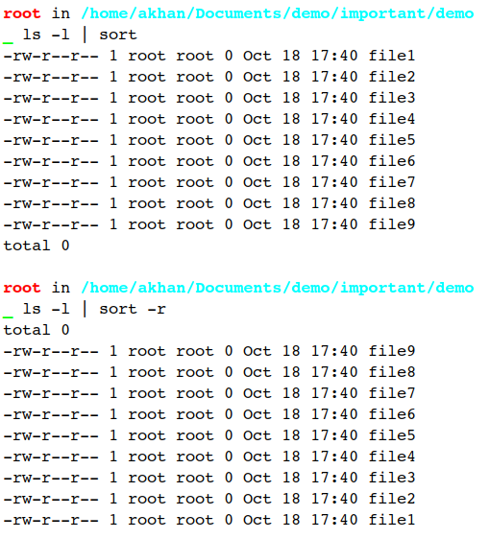
Pipes
Pipes allow stdout of one program to be stdin of another
- The output of the command to the left of ‘|’ becomes the input of the command on its right

Slide 11
Regular Expressions and Metacharacters
Regular expressions are a powerful means for pattern matching and string parsing that can be applied in so many instances. With regular expressions you can:
Validate text input
Search (and replace) text within a file
Batch rename files
Undertake incredibly powerful searches for files
Interact with servers like Apache
Test for patterns within strings
And much more

Slide 12
What makes up Regular Expressions ?
There are two types of characters to be found in regular expressions:
Literal characters
Metacharacters
Literal characters are standard characters that make up your strings. Every character in this sentence is a literal character. You could use a regular expression to search for each literal character in that string.
Metacharacters are a different beast altogether; they are what give regular expressions their power. With metacharacters, you can do much more than searching for a single character. Metacharacters allow you to search for combinations of strings and much more.

Slide 13
What makes up Regular Expressions ? (contd.)
^ Indicates the beginning of an input string
$ Indicates the end of the an input string
* Indicates the preceding subexpression is to be matched zero or more times
+ Indicates the preceding subexpression is to be matched one or more times
? Indicates the preceding subexpression is to be matched zero or one time
{n} Match exactly n times (Where n is a non-negative integer)
{n,} Match at least n times (Where n is a non-negative integer

Slide 14
What makes up Regular Expressions ? (contd.)
{n,m} Match at least n and at most m times (Where m and n are non-negative integers and n <= m)
. Matches any single character except “n”
[xyz] Match any one of the enclosed characters
x|y Match either x or y
[^xyz] Match any character not enclosed
[a-z] Matches any character in the specified range.
[^a-z] Matches any character not in the specified range

Slide 15
Mixing Inputs from Standard Input and a File
When we type something into our terminal program, we’ll often see output. For example:
$ echo hello
hello
As we can see above, echo hello is the command that output “hello”, but where has the output really go?
The default place for the output to go is the shell screen which you are connected to. It is the space with which we are informed about the responses of the commands, even if they weren’t able to execute successfully.

Slide 16
Mixing Inputs from Standard Input and a File (Contd.)
Consider the example of wc command.
We are counting the number of lines in file1.
Then we are streaming the contents of file1 to the same wc command, with standard input redirection ( stdin )
Next we are streaming the stdout of the command to a new file file1.line_count.

Slide 17
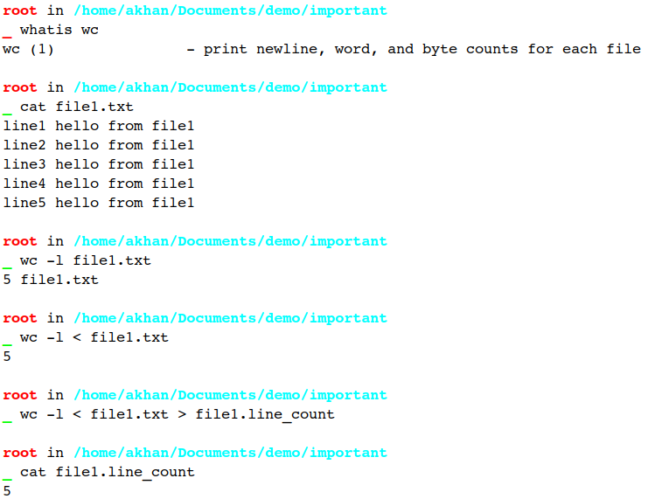
Mixing Inputs from Standard Input and a File (Contd.)

Slide 18
Filters
Filters are programs that take plain text(either stored in a file or produced by another program) as standard input, transforms it into a meaningful format, and then returns it as standard output.
Linux has a number of filters. Some of the most commonly used filters are:
cat : Displays the text of the file line by line.
head : Displays the first n lines of the specified text files. If the number of lines is not specified then by default prints first 10 lines.

Slide 19
Filters (Contd.)
tail : It works the same way as head, just in reverse order. The only difference in tail is, it returns the lines from bottom to up.
sort : Sorts the lines alphabetically by default but there are many options available to modify the sorting mechanism.
uniq : Removes duplicate lines.
wc : wc command gives the number of lines, words and characters in the data.

Slide 20
Filters (Contd.)
grep : grep is used to search a particular information from a text file.
sed : sed stands for stream editor. It allows us to apply search and replace operation on our data effectively. sed is quite an advanced filter.
tr : tr stands for translate, it is used for translating or deleting characters

Slide 21
tee Command
tee [-a] file
The tee command can be used to send standard output to the screen and to a file simultaneously.
make | tee build.log
Runs the make command and stores its output to build.log.
make install | tee –a build.log
Runs the make install command and appends its output to build.log

Slide 22
Terminal (/dev/tty) and Trash (/dev/null) Files
Both /dev/tty and /dev/null are character device file.
tty is a special file representing the 'controlling terminal' for the current process.
/dev/tty is a special file, representing the terminal for the current process. So, when you echo 1 > /dev/tty -> your message (1) will appear on your screen

Slide 23
Terminal (/dev/tty) and Trash (/dev/null) Files (contd.)
/dev/null is a special file called the null device in Unix systems. Colloquially it is also called the ‘blackhole’ because it immediately discards anything written to it and only returns an end-of-file.
echo 1 > /dev/null -> your message ('1') will disappear.

Slide 24
Revisiting uniq, sort & tr commands
uniq : Removes duplicate lines.
sort : Sorts the lines alphabetically by default but there are many options available to modify the sorting mechanism.
tr : tr stands for translate, it is used for translating or deleting characters. It supports a range of transformations including uppercase to lowercase, squeezing repeating characters, deleting specific characters and basic find and replace.

Slide 25
Thank You!

